Slide 1
BE1003:
Database Basics
Database
10 October 2023
Raffles Hall Developers AY23/24

Slide 2
What is a Database?
Organized collection of structured information, or data, typically stored electronically in a computer system. A database is usually controlled by a database management system (DBMS). Together, the data and the DBMS, along with the applications that are associated with them, are referred to as a database system, often shortened to just database.
Raffles Hall Developers AY23/24

Slide 3
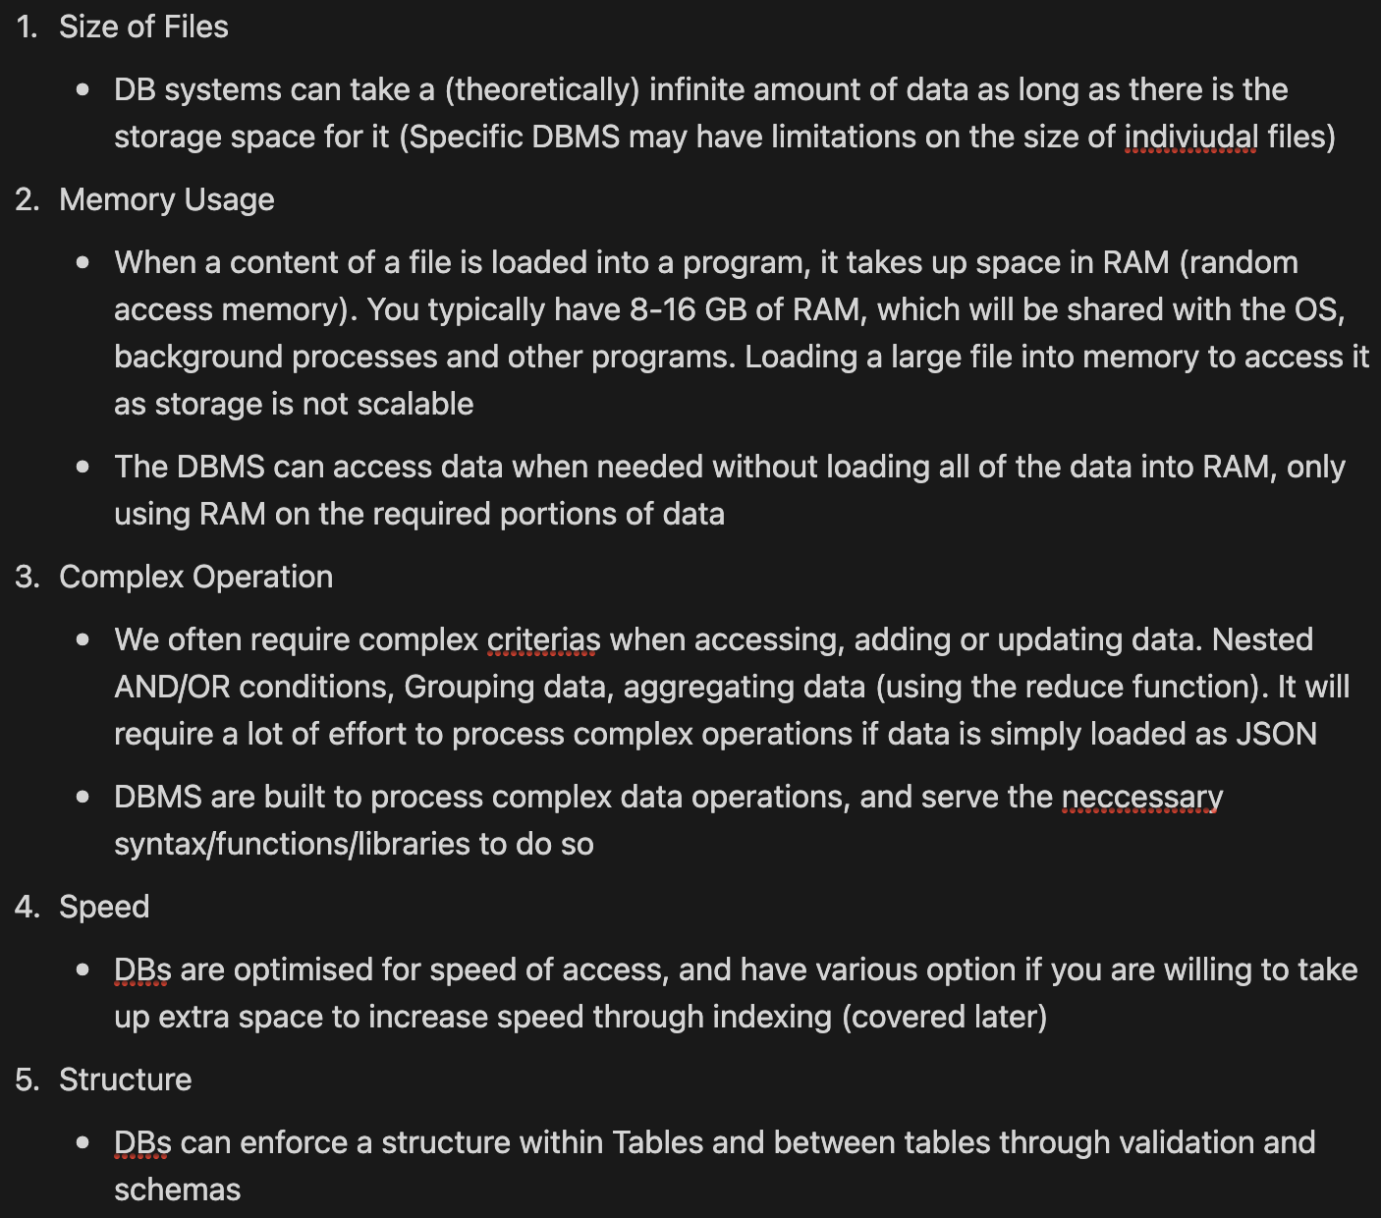
Why Database?
Raffles Hall Developers AY23/24

Slide 4
Basic Terminology
Table (SQL) / Collections (NoSQL)
Table is a collection of data in DB → table of data. Items in a table should be of the same group (e.g. Students)
Row (SQL) / Entry (NoSQL)
Specific item in a table (e.g. Specific student)
Columns (SQL) / Fields (NoSQL)
Data fields in an try (e.g. id of student)
Primary Key (PK)
Field(s) that uniquely identifies an entry in a DB. Common PKs are running indexes; or identifiers (NRIC / randomly assigned string - uuid)
Foreign Key (FK)
Connect tables using the values in their fields. The field(s) that connect 2 tables are FK(s)
Raffles Hall Developers AY23/24

Slide 5
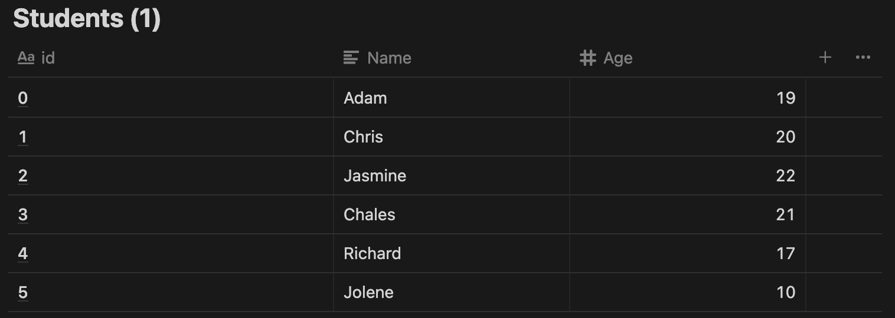
Indexing
Raffles Hall Developers AY23/24
Notes:
The data is indexed according to their id (can think of it similar to an array index. You can access any entry using their index in O(1) (generally).

Slide 6
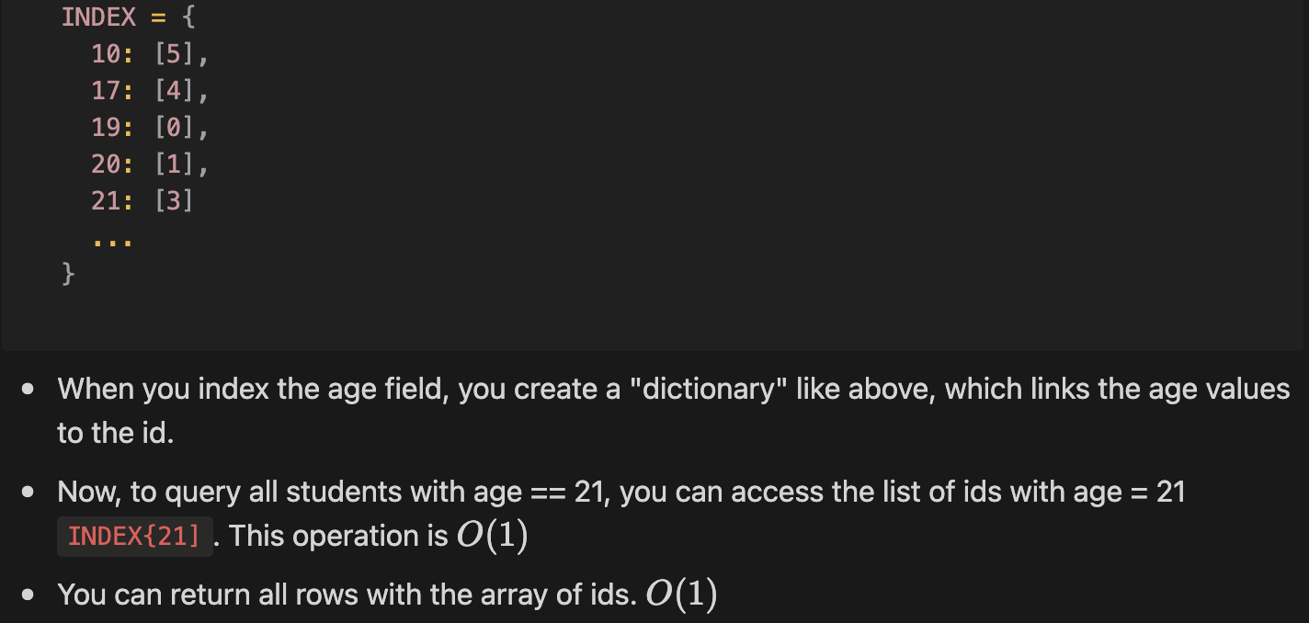
Indexing
Query: Return all students with age == 21
- With the given structure above, you can only complete this in O(n) by checking every student by their id.
- To complete this with O(1), we must create an index on the age field
Raffles Hall Developers AY23/24
Notes:
The data is indexed according to their id (can think of it similar to an array index. You can access any entry using their index in O(1) (generally).

Slide 7
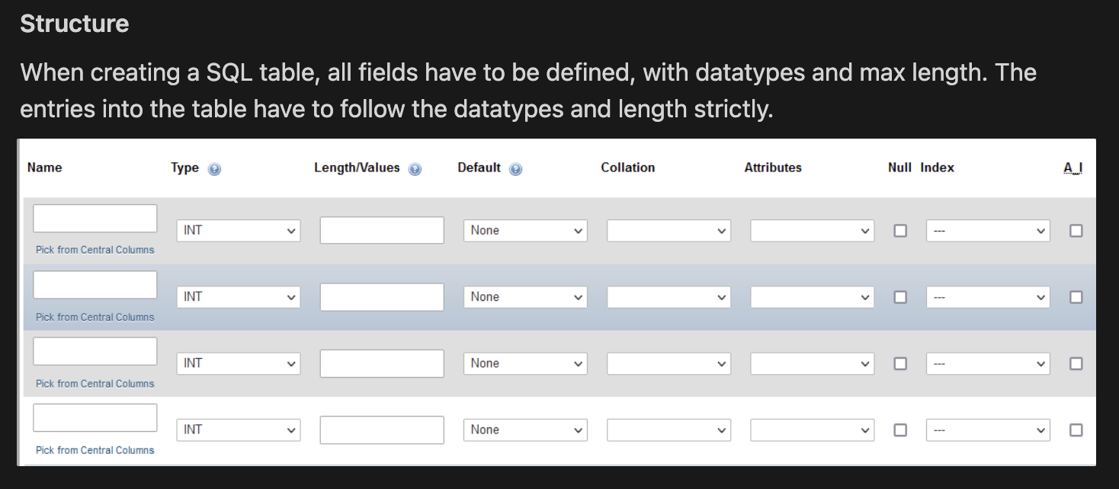
SQL vs NoSQL
Standard Query Language (SQL): Uses structured query language for queries. Relational database.
SELECT * FROM `students` WHERE `students.id` = 2;
# Returns all rows, all fields from `students` where id field = 2
→ Pass the SQL command as a str and the python package will convert it to a SQL query and pass to the DMS
result = await db.execute("SELECT * FROM `students` WHERE `students.id` = " + form["id"]+ ";")
Raffles Hall Developers AY23/24

Slide 8
SQL vs NoSQL
NoSQL: Use more conventional programming-like code to run queries. NoSQL are also non-relational databases
db.Students.find_one({"age": 21})
Structure
NoSQL db do not require their structure to be predefined. There can be any number of fields and any name with values of any type. Fields can be added on the go without affecting previous entries.
Fields in NoSQL are typically just in JSON format
Validation can be available to check the type and format of the data.
Raffles Hall Developers AY23/24

Slide 9
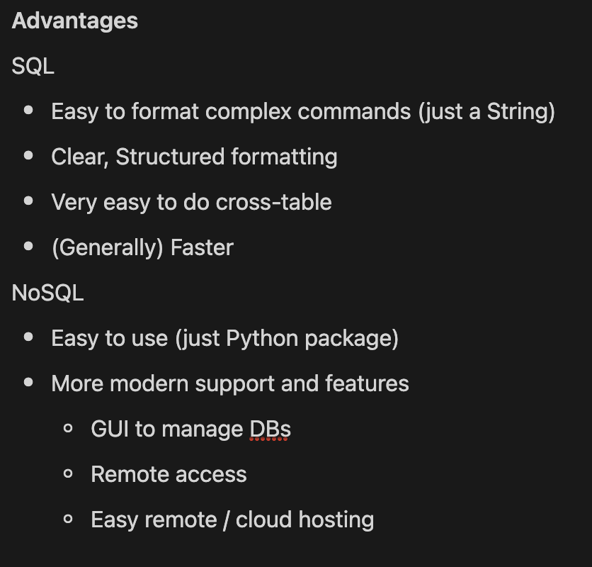
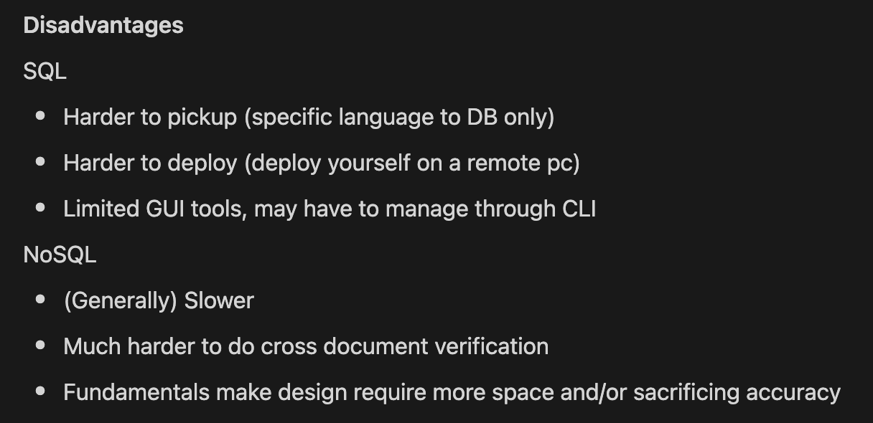
SQL vs NoSQL
Raffles Hall Developers AY23/24

Slide 10
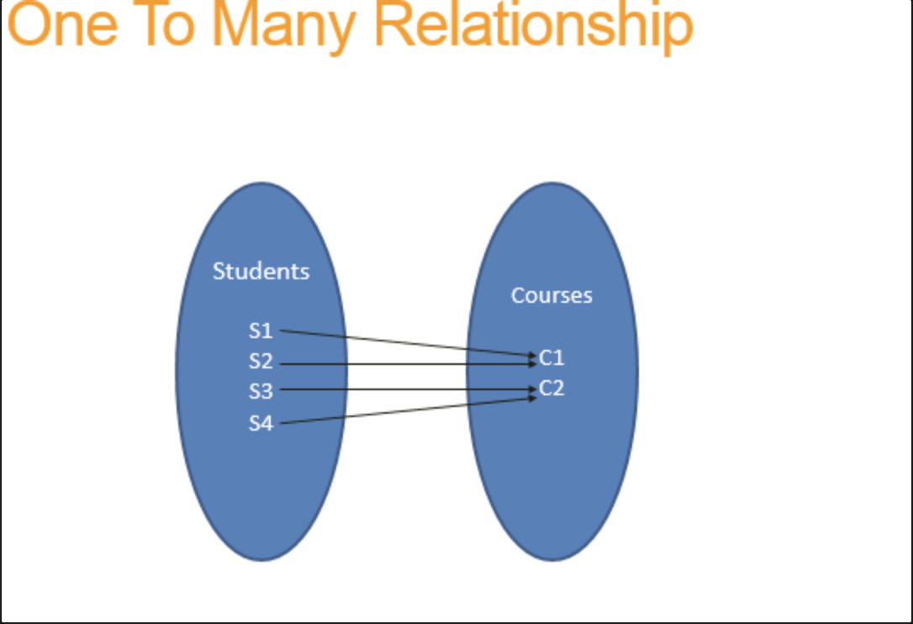
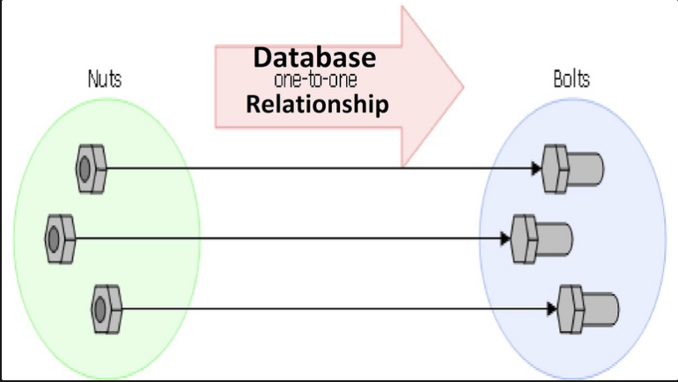
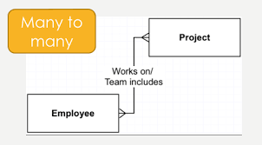
Relations
Describes how connected tables are related to each other.
Types of relationships
One-to-One
One-to-Many
Many-to-Many
Raffles Hall Developers AY23/24
Notes:
For a one-to-one relation between A and B, A can only be related to 1x B and B can only be related to 1x A
Example: Each bolt can only be connected to 1 nut, each nut can only be connected to 1 bolt
One-to-Many
For a many-to-one relation between A and B, A can only relate to 1x B, B can relate to many As
Example: Each student can only have 1 course. Each course can have many students
Many-to-Many
A can relate to many B, B can relate to many A (no restrictions)
Each student can have many CCAs, each CCAs can have many students

Slide 11
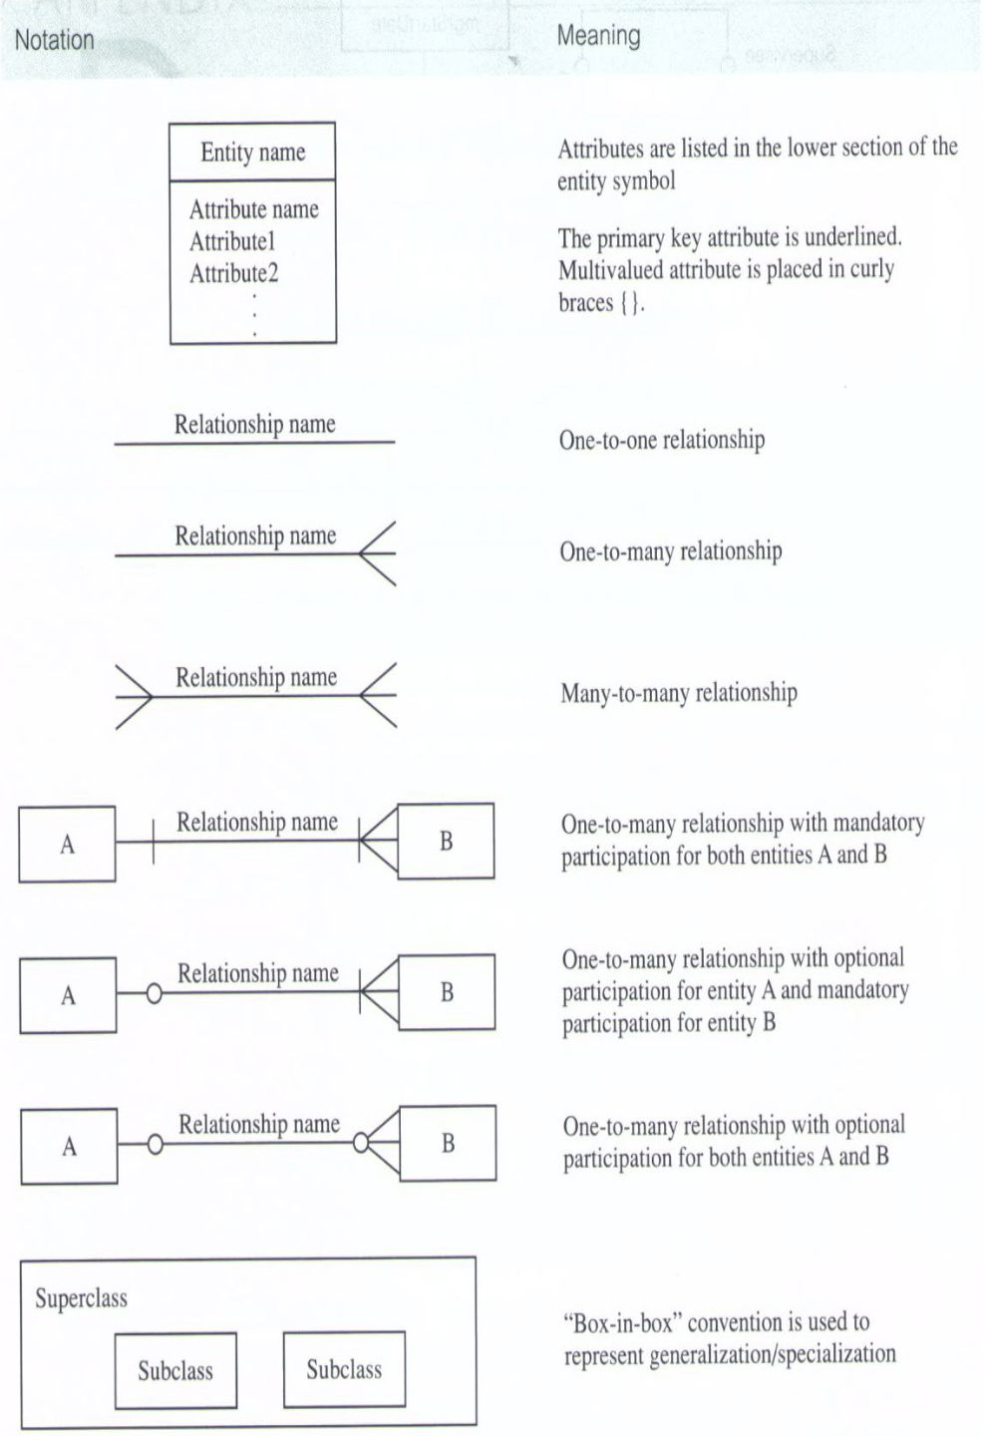
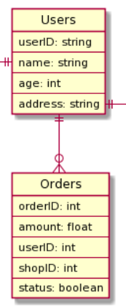
Drawing ERD Diagrams
Raffles Hall Developers AY23/24
Notes:
For a one-to-one relation between A and B, A can only be related to 1x B and B can only be related to 1x A
Example: Each bolt can only be connected to 1 nut, each nut can only be connected to 1 bolt
One-to-Many
For a many-to-one relation between A and B, A can only relate to 1x B, B can relate to many As
Example: Each student can only have 1 course. Each course can have many students
Many-to-Many
A can relate to many B, B can relate to many A (no restrictions)
Each student can have many CCAs, each CCAs can have many students

Slide 12
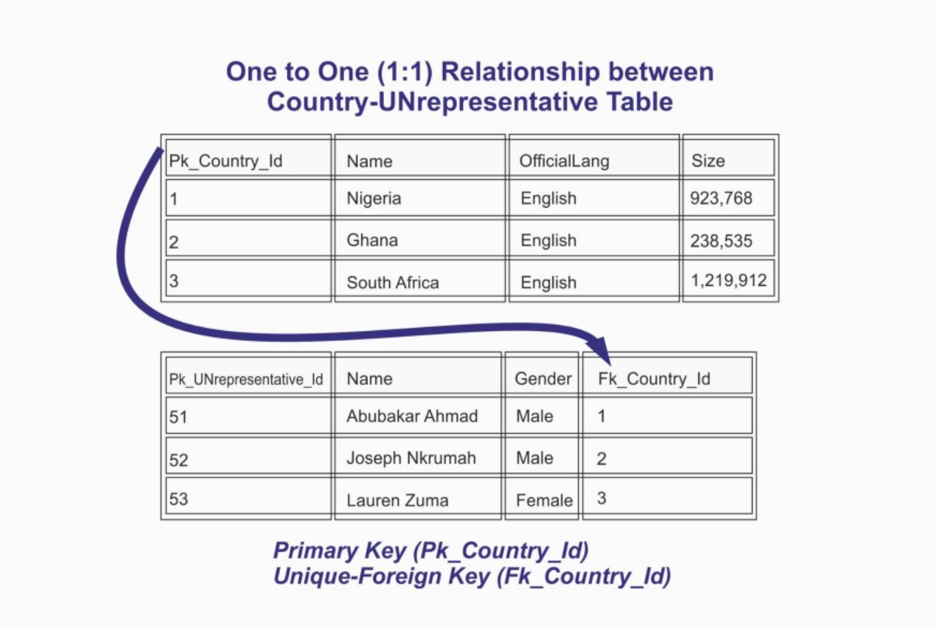
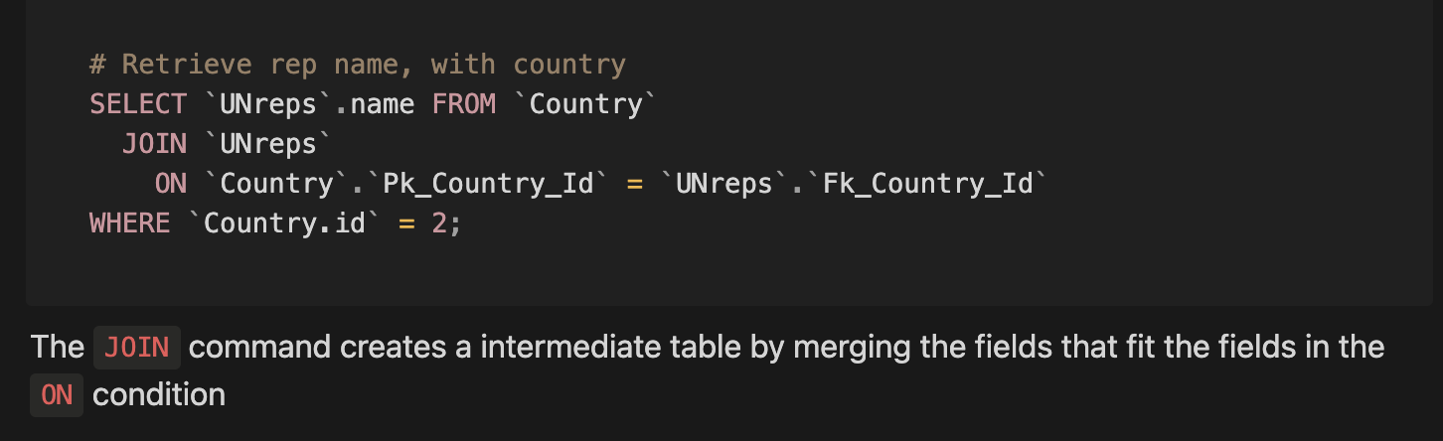
Relations - Foreign Keys
The general rule of thumb for relational DB is to use many tables that individually have minimal fields. The purpose of this is to work with the smallest number of fields in every query to increase speed.
Raffles Hall Developers AY23/24

Slide 13
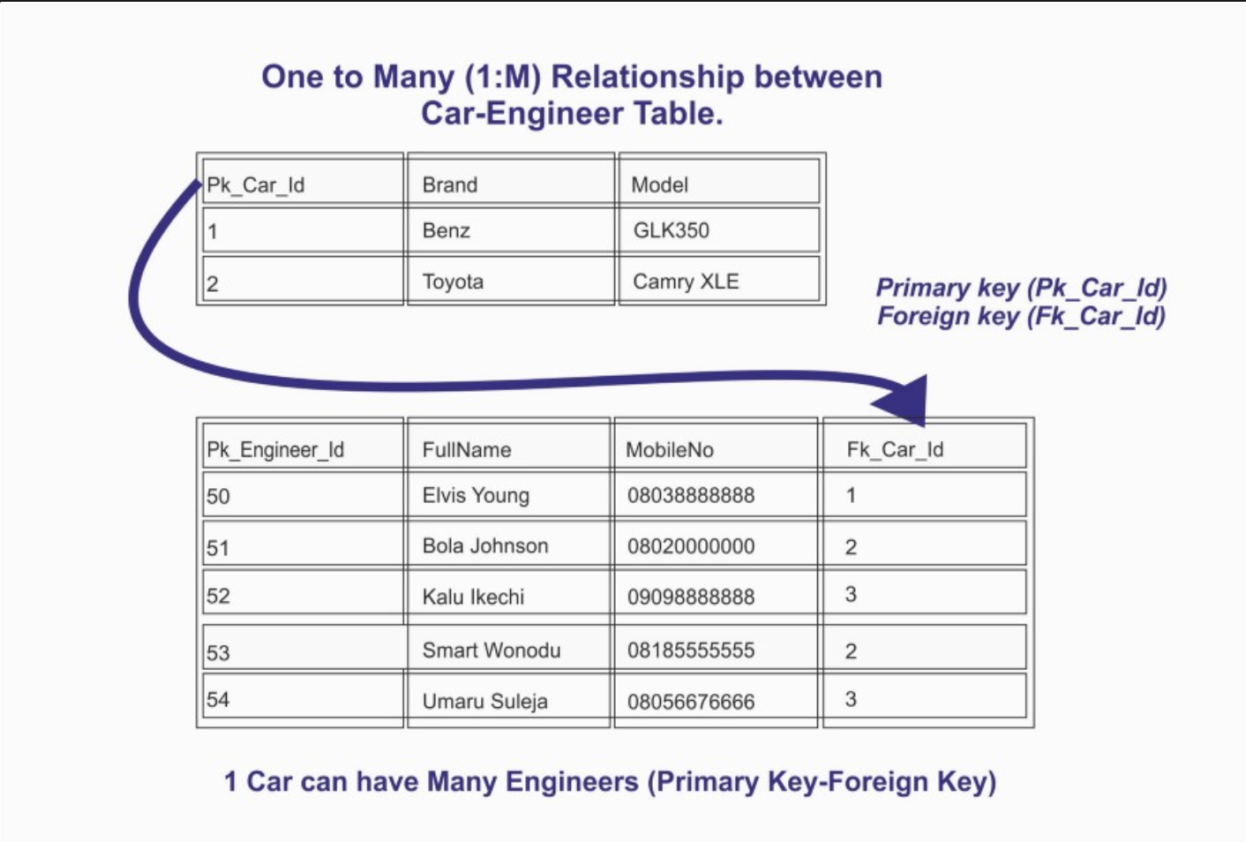
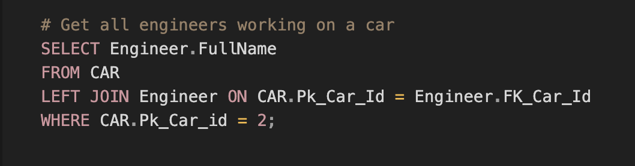
Relations - Foreign Keys
Raffles Hall Developers AY23/24
Notes:
Result will be multiple rows, each row with a name of a engineer

Slide 14
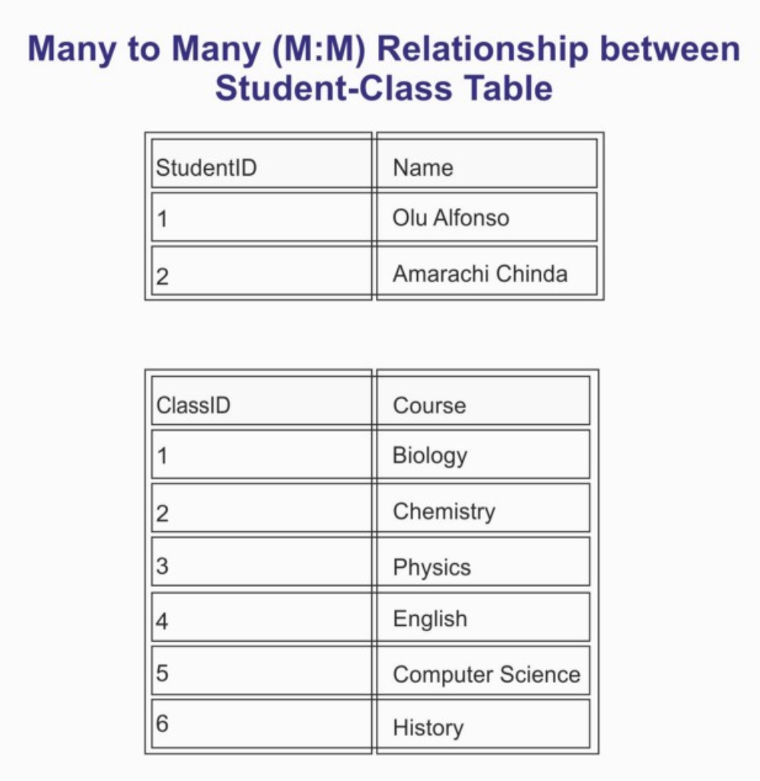
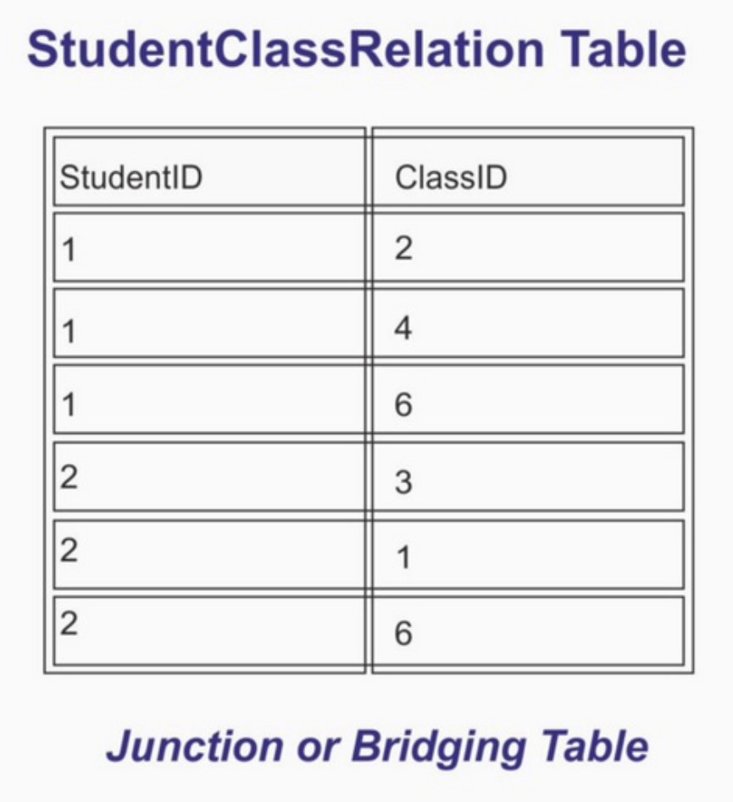
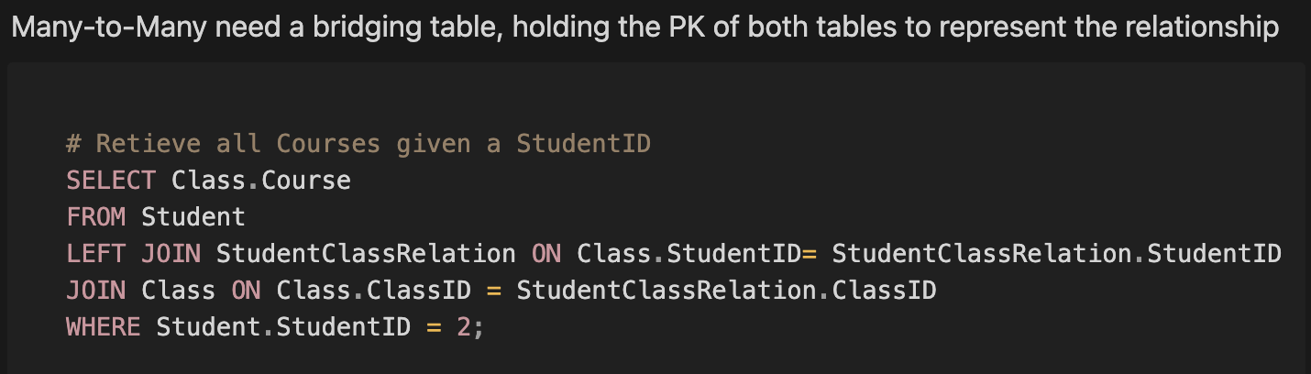
Relations - Foreign Keys
Raffles Hall Developers AY23/24
Notes:
Result will be multiple rows, each row with a name of a engineer

Slide 15
Enforcing Relationships
The purpose for setting up a FK constraint is to ensure that any value in 1 table has a corresponding row in another table. This presents a barrier when we are updating or deleting a constrained column. There are 4 ways the DBMS can handle the update/delete
CASCADE
If the foreign value is updated, the constrained value will be updated as well
If the foreign value is deleted, the row containing the constrained value will be deleted
Example: If matric cardID is updated, reference is updated. If matric card is deleted, student is deleted
Warning: Cascade can cause accidental deletion of data
SET NULL
On update/delete of foriegn value, simply set the constrained value to null
May cause "Phantom" values
RESTRICT
If there is a FK restriction on that value, block all updates/deletes
Usually the most careful options, requires more queries for same task
NO ACTION
Equivalent to not having a FK
Raffles Hall Developers AY23/24
Notes:
Result will be multiple rows, each row with a name of a engineer

